Slide 1
Project 3
Procedures
Custom Queries And Propositions
Edwin Ramos, Michael Chang, Jay Mistry, Akashdeep Singh, Diyor Zoirov, Carlos Salinas, Bing Gao

Slide 2
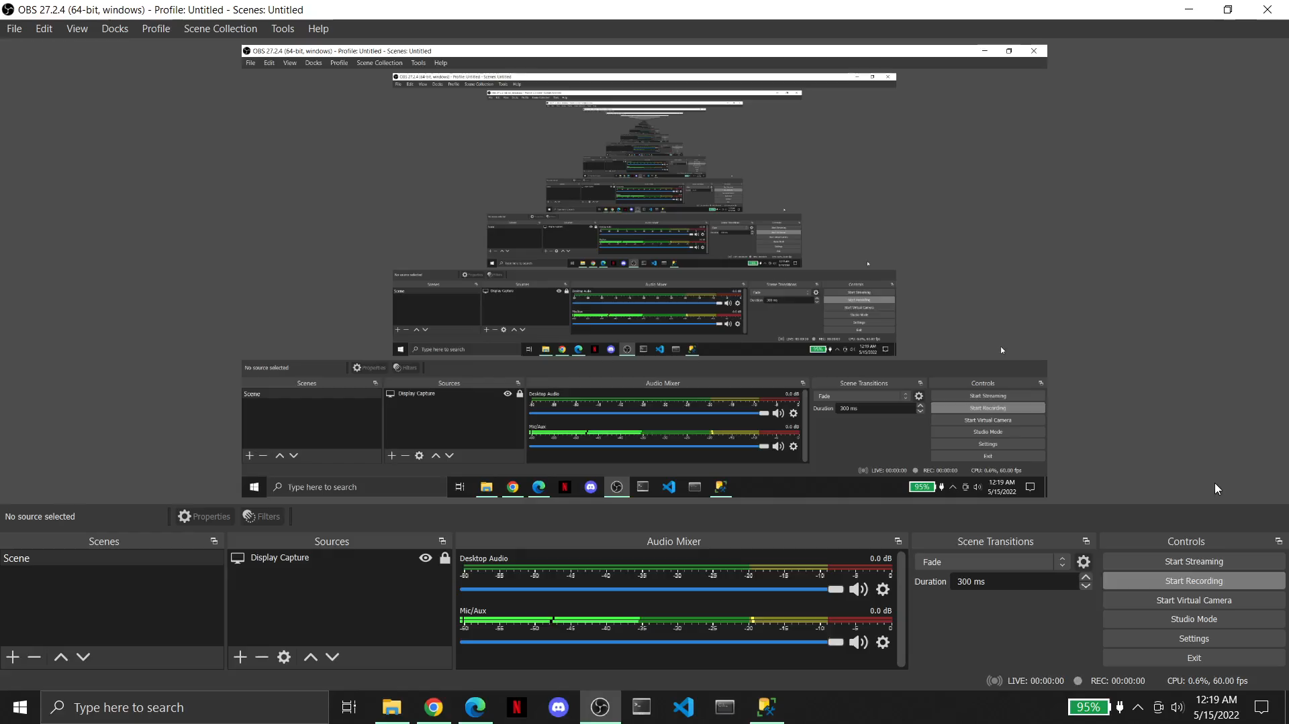
Jay Custom Propositions and Queries Mp4

Slide 3
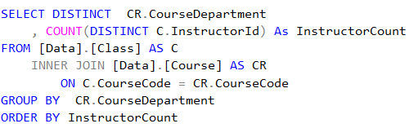
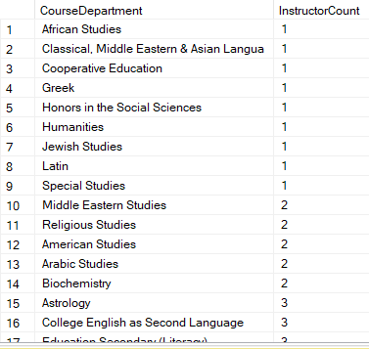
Jay Custom Propositions and Queries
Proposition: How many instructors are in each department?
Tables Involved: Data.Class & Data.Course

Slide 4
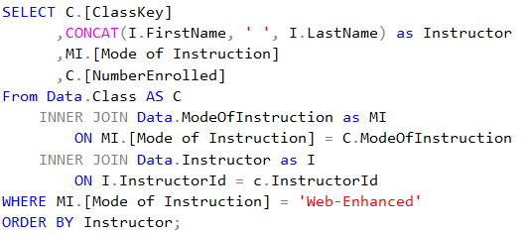
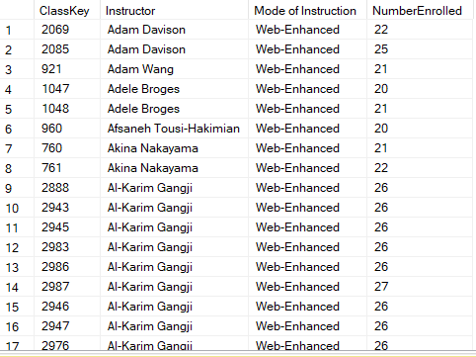
Jay Custom Propositions and Queries
Proposition: Shows the name of the Instructors who teach Online classes and the number of total students enrolled
Tables Involved: Data.Class, Data.Instructor and Data.ModeOfInstruction

Slide 5
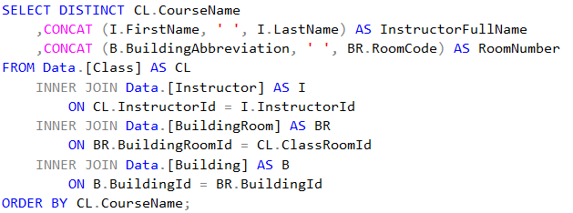
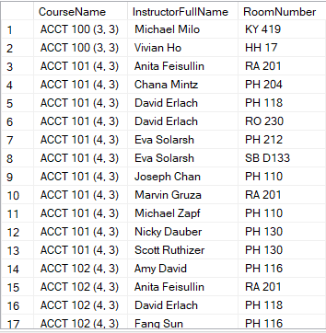
Jay Custom Propositions and Queries
Proposition: Show which rooms the instructors are teaching in
Tables Involved: Data.Class, Data.Instructor, Data.Building & Data.BuildingRoom

